Slide 1

NETWORKING &
DEVELOPING YOUR
LinkedIn PROFILE

Slide 2
Overview
Networking
LinkedIn
Features and Benefits of LinkedIn
Steps in Profile Development
Tips
LinkedIn Usage

Slide 3
What is Networking?
Talking with people who will learn about you and your interests, and then help you gain insight into your career options and goals
It is a two-way process that involves developing and maintaining connections with individuals, and mutually benefitting from the relationship
Is an ongoing process that takes time and attention; it is not something you do only when you are looking for a job

Slide 4
What is Networking?
Successful networking requires preparation and practice
Networking can be done in-person and online. A valuable tool for online networking is LinkedIn
Remember, when you network, you are asking for information and advice—not a job. It’s not just what you know; it’s also whom you know… or can connect to

Slide 5
Why is Networking important?
Will be the single most effective method of advancing your career
While networking may not “get you a job,” it does play a role in the majority of hiring decisions
Many job vacancies are never advertised, but instead filled through some form of personal or professional referrals
Employers prefer to hire candidates they have met, or those referred by a trusted source

Slide 6
Build Your Network
Networking opportunities occur on a daily basis and can include a brief conversation with someone on an elevator to an arranged meeting with a professional
Identify all the people whom you come in contact with through your activities. These can include:
Your friends, classmates, their parents and family members, neighbors.
Your relatives and extended family.
Former and current employers and co-workers.
Members and alumni of professional associations, clubs, and organizations.
Coaches, staff, faculty, or academic advisors.
Alumni of any schools you’ve attended.

Slide 7
Expand Your Network
Attend campus career events and fairs, alumni presentations, and workshops
Introduce yourself to any guest speakers you encounter on campus
Obtain an internship and maintain contact with colleagues and supervisors
Take advantage of job-shadowing programs
Identify contacts by researching LexisNexis, industry/trade publications, employer websites, alumni magazines, and library resources
Create a LinkedIn profile; connect to your contacts and join groups as appropriate

Slide 8
What is LinkedIn?
https://youtu.be/ZVlUwwgOfKw

Slide 9
What is LinkedIn?
The world’s largest online professional networking platform
Hosts the profiles of more than 500 million people in over 200 countries
Serves as a recruiting tool for employers
Serves as a job search tool for users

Slide 10
Features and Benefits of LinkedIn
Establish your professional profile and control one of the top search results for your name.
Build and maintain your professional network.
Find and reconnect with colleagues and classmates.
Learn about other companies, and gain industry insights.
Find other professionals in the same industry using groups.
Share your thoughts and insights through LinkedIn's long-form publishing platform.
Tap into the knowledge of your network.
Discover new career opportunities by searching for jobs.

Slide 11
Steps in Profile Development
Sign-up: Name, email address, password
Add location information
Add profile photo (background image optional)
Create a headline
Write a summary statement
Other key sections to complete: Showcase your unique professional story through your experience, skills, and education
LinkedIn tips for students: https://students.linkedin.com/

Slide 12
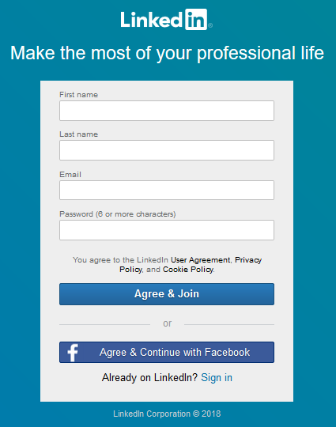
Getting Started
Go to the sign-up page at https://www.linkedin.com/start/join
You can sign-up via your Facebook or Email account

Slide 13
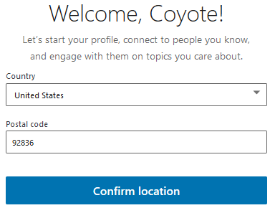
Location Information
Recruiters look for job seekers by location
Adding your location makes you 23 times more likely to be found in LinkedIn searches
Use a zip code that is close to the area where you want to work
Notes:
If you are able to work in Riverside but live 25 miles away in a different city, use a zip code halfway between the two locations that will capture searches looking for someone within a 10-mile radius of either Riverside or your city.

Slide 14
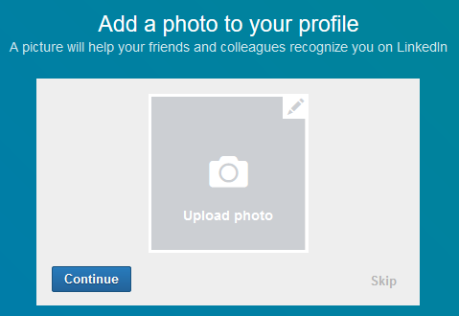
Profile Photo
Having no LinkedIn profile photo means your profile is not 100% complete
According to LinkedIn, profiles with photos receive 21 times more views and 9x more connection requests
LinkedIn Profile Photo Help: https://www.linkedin.com/help/linkedin/topics/6042/6059
Notes:
An engaging profile photo and background create a personal relationship with your viewers.
You will be more likely to be contacted by many recruiters.
People will see you as friendly and professional.
People will be encouraged to read more about you.

Slide 15
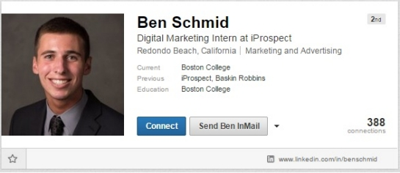
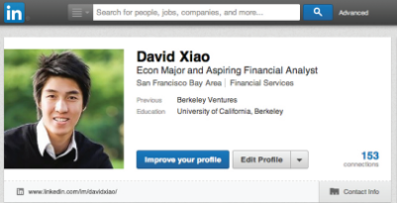
Profile Photo Samples & Tips
Professional head shot (is recommended)
Plain background
No distractions in view
If taken outside, natural light works well
Make sure you portray yourself as you want to be seen by your intended audience
Notes:
Depending on your industry, you might choose to post a more or less formal photo.
Privacy concern: As an alternative to posting your photo publicly, you can change your connections or only to your network. This step may deter someone from asking for a connection based on visual interests alone, if that is a concern.
Concern about discrimination such as age or race: Would you want to work for a company that doesn’t contact you because of something they see in your picture? If they are going to discriminate, chances are they will do it in the interview if they don’t have a chance to make judgements based on your photo and you may be overlooked if you don’t have one at all.

Slide 16



Background Image
LinkedIn has a standard option available to use or as a premium user you have access to LinkedIn stock images
Another option is to create a custom background image using one of the following online tools:
www.canva.com
www.fotor.com
www.picmonkey.com
Background Image Help: https://www.linkedin.com/help/linkedin/answer/49960?query=background%20image
Notes:
Get a professional head shot with a plain background, natural light is also good, smile and look directly at camera
If your photo includes a dog, cat, husband, or a lot of unnecessary objects in the background, viewers might think you’re immature or unprofessional, or simply be distracted

Slide 17

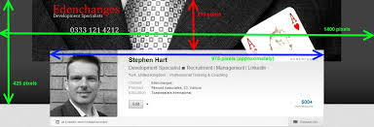
Ideas For Background Images
LinkedIn stock image
Your product or service in the making
Your product or service in action
The skyline of your current city
Design your own
A personal image
Article: Seven ideas for an effective LinkedIn background image: https://www.linkedin.com/help/linkedin/answer/49960?query=background%20image
Notes:
Get a professional head shot with a plain background, natural light is also good, smile and look directly at camera
If your photo includes a dog, cat, husband, or a lot of unnecessary objects in the background, viewers might think you’re immature or unprofessional, or simply be distracted

Slide 18
Profile Content Tips
“The first hurdle is to get found (to make sure you come up in the right kind of searches by recruiters).”
-Catherine Byers Breet, Longtime recruiter and adopter of LinkedIn (member since 2005)
Use industry-relevant job titles and keywords
Once you identify your top keywords, add as many of them to the following sections: Headline (most important), Current Job Title, Summary, Interests
The LinkedIn search tool searches entire profiles, so insert your keywords throughout!

Slide 19
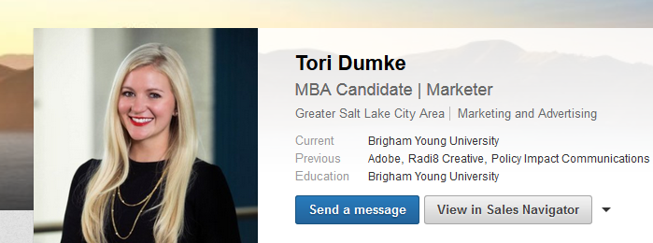

Headline
Examples
Depends on your LinkedIn profile goals
Can be general and straightforward
Can also tell viewers what makes you unique and includes as many keywords as possible
Headline Help: https://www.linkedin.com/help/linkedin/topics/6042/6043/2901

Slide 20
Summary Statement
Main place for you to stand out; adds a ‘story’ element to your experience and your aspirations
Be concise about your experience, qualifications, and goals – with a compelling narrative weaved throughout (if possible)
Describes what motivates you, what you’ve done and are skilled at
Use keywords and phrases that recruiters might search for (i.e. product management, graphic design, data analysis)
https://www.linkedin.com/pulse/10-tips-students-new-grads-linkedin-omar-garriott

Slide 21
Summary Statement
How to write a stellar summary:
Set the scene:
What is your ideal audience? What do you want them to know, learn, or do?
How do you want to make them feel?
Collect content
What you do, accomplishments, values and passions, your “superpowers”, interesting stats, differentiation, validation (back up what you’re saying)
Source: https://www.forbes.com/sites/williamarruda/2017/07/09/how-to-write-a-stellar-linkedin-summary/2/#271686b3067a

Slide 22
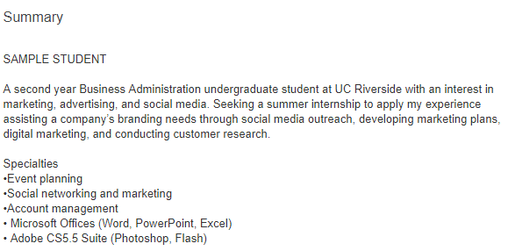
Summary Statement
https://www.linkedin.com/in/studentsample

Slide 23
Education
Education is the foundation!
Members who list a school get 10x more views on average
Add your school, major, and degree name
Include clubs you lead and honors you have earned

Slide 24
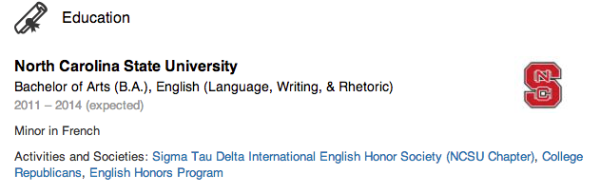
Education

Slide 25
Experience
When listing your experience:
Avoid listing only duties and responsibilities
Use action words and accomplishments
Examples:
Analyzed materials….
Conducted individual….
List projects, organizations, classes, etc.
Similar to resume
Most related at the top
41% of hiring managers consider volunteer experience equally as valuable as paid work experience

Slide 26
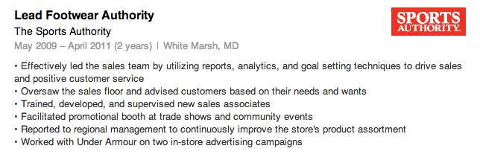
Experience

Slide 27
Skills
List tangible skills that you are comfortable using in the workplace
Skills can be acquired on the job or in school
Speak Mandarin?
Know JAVA programming?
17% more profiles views with 5+ skills listed

Slide 28
Tips to get you started
Complete your profile
Claim your unique URL
Participate in groups
Connect with people you know:
Friends, family, classmates, mentors, teachers, and
professors
Use the alumni tool
Actively update your profile

Slide 29
Participate in Groups
LinkedIn Groups are hubs on LinkedIn which provide a “place for professionals in the same industry or with similar interests to share content, find answers, post and view jobs, make business contacts, and establish themselves as industry experts.”
“Being an active participant in a group can help you network with other professionals in your field, especially those outside your immediate circle…”
https://blog.hootsuite.com/linkedin-groups/

Slide 30
Final Words...use LinkedIn to:
Browse job descriptions
Set up job alerts
Follow
Companies
Influencers
Industries---trends and news

Slide 31
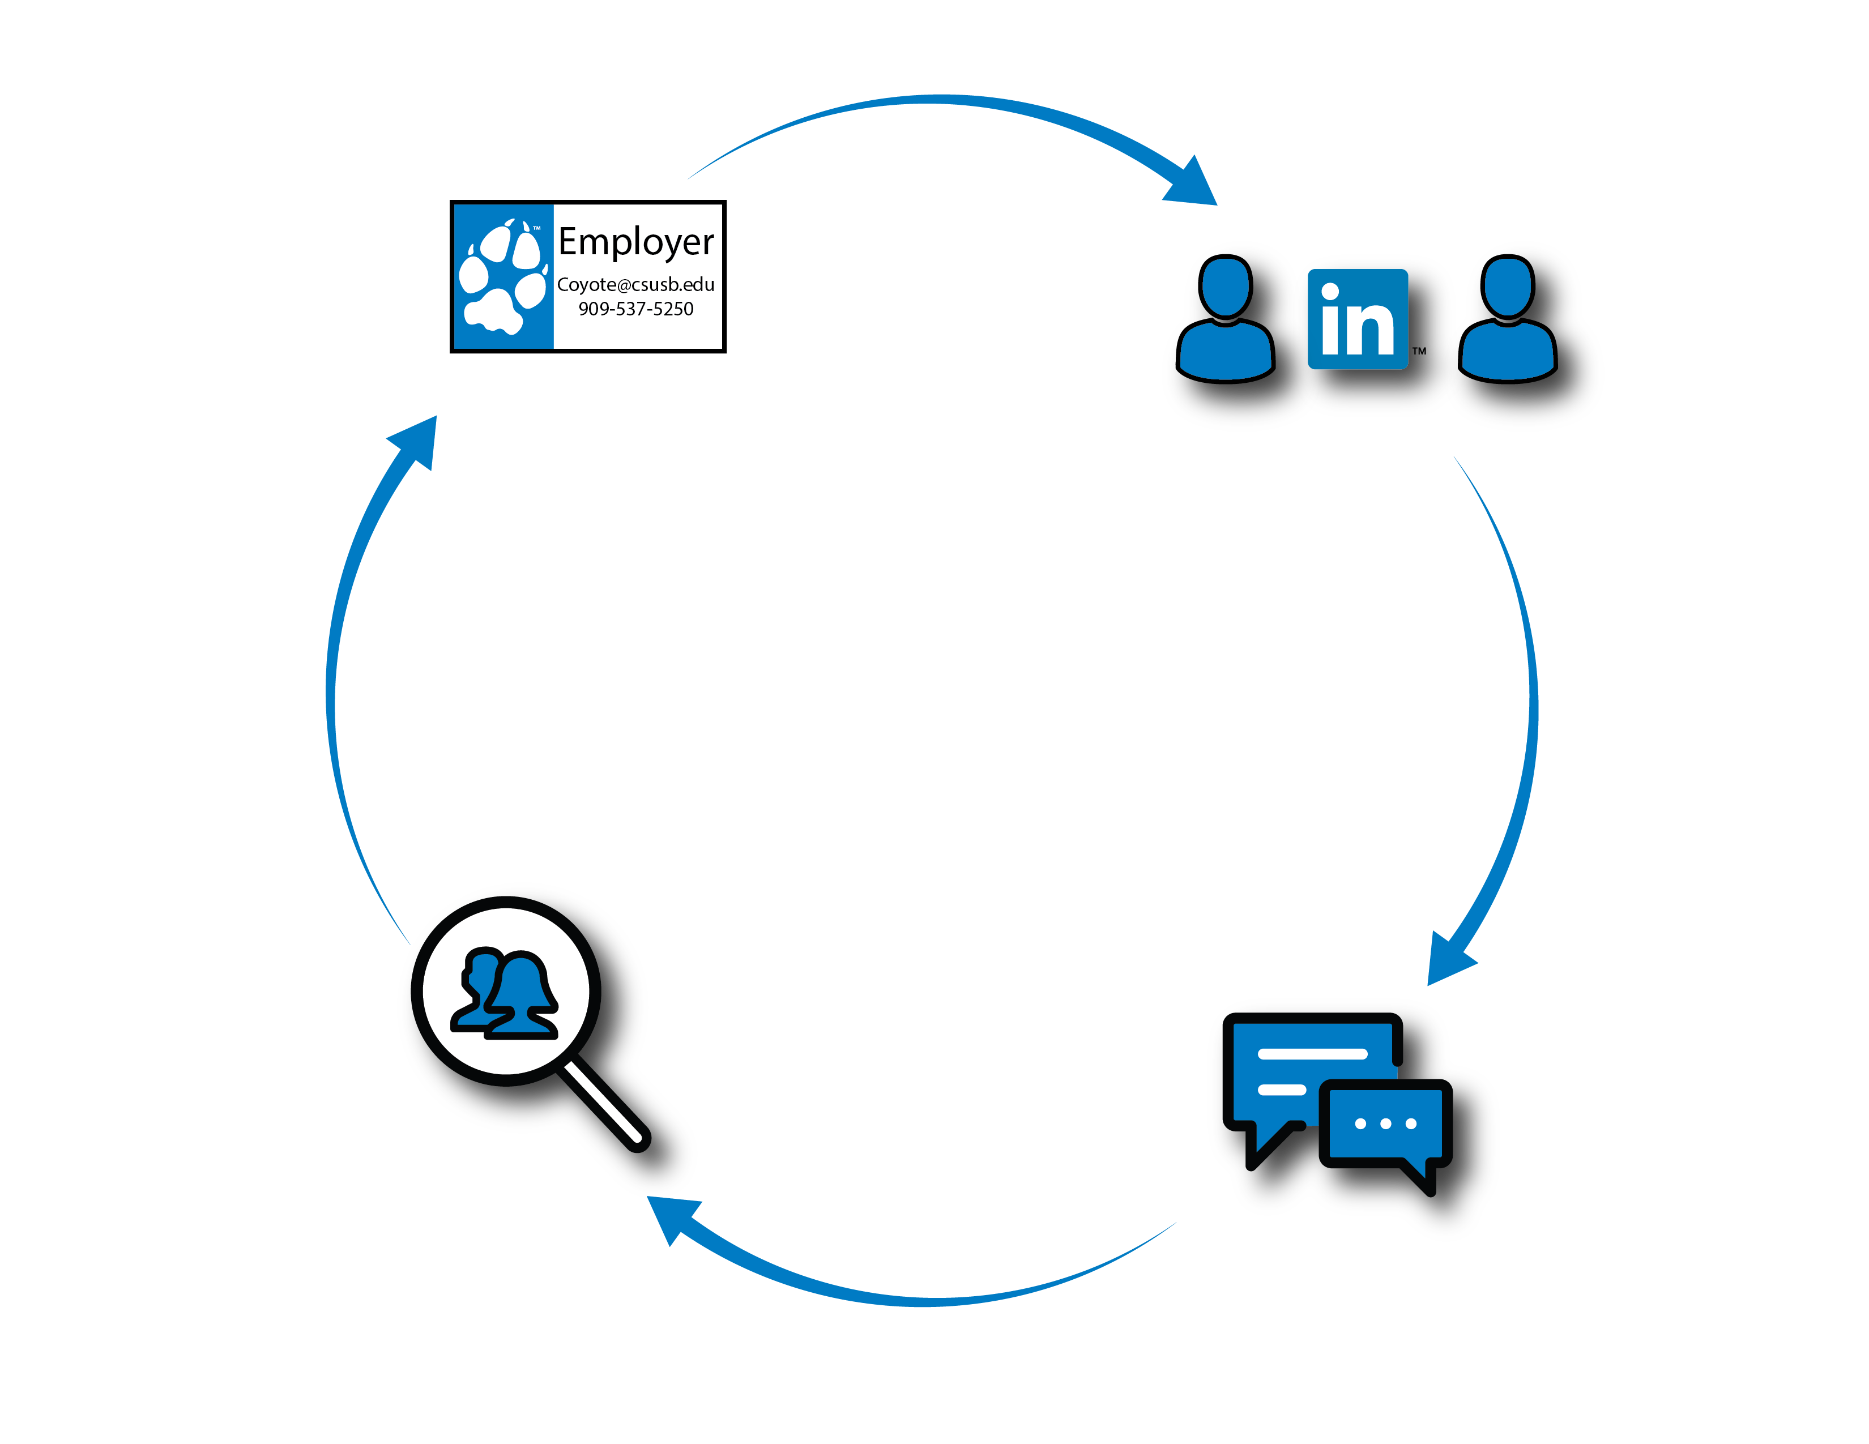
Notes:
Describe how LinkedIn is a cycle----not just a one time connection
You get a business card, find them on LinkedIn, message them, search for opportunities and then plug in at different times when you need to connect for mentorship, internships, or a job

Slide 32
Additional Resources
Student Job Seekers: Tips to Building the Perfect LinkedIn Profile https://blog.linkedin.com/2016/11/14/student-job-seekers-tips-to-building-the-perfect-linkedin-profile
LinkedIn Etiquette: 20 Do’s & Don’t’s
https://www.linkedin.com/pulse/20140417174121-34888774-linkedin-etiquette-guide-20-do-s-don-ts/

Slide 33

Book Reference

Slide 34

Career Center Information
Main Campus
University Hall 329
Phone: 909-537-5250
Email: careercenter@csusb.edu
Website: www.csusb.edu/career-center
Palm Desert Campus
Indian Wells 111
Phone: 909-537-8243
Email: pdccareercenter@csusb.edu
Website: https://pdc.csusb.edu/current-students/career-service
Notes:
Palm Desert Campus
Hours: 8:00 am - 5:00 pm
Location: IW-111
Phone: (909) 537-8243
Email: pdccareercenter@csusb.edu

